Slide 1

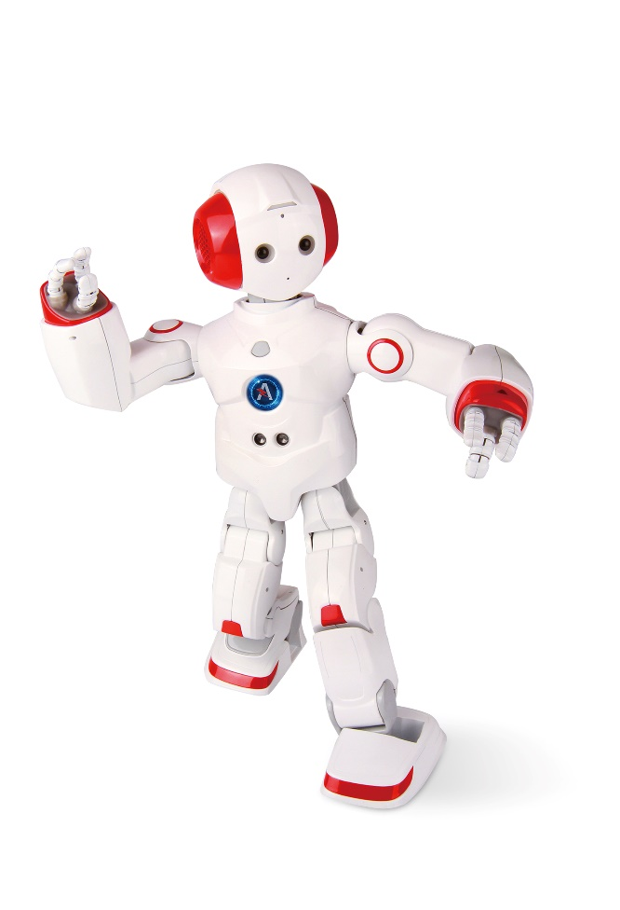


HI-TECH Camp for Champs by The Little Engineer
+

Slide 2

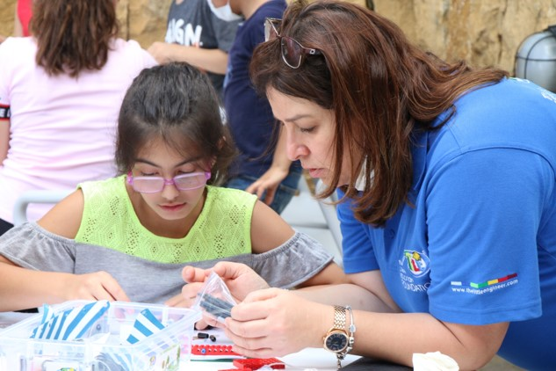
Who we are?

Slide 3

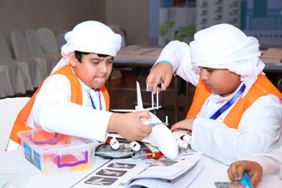
TLE® Acquired Skills

Slide 4
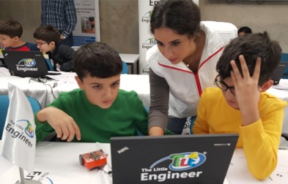
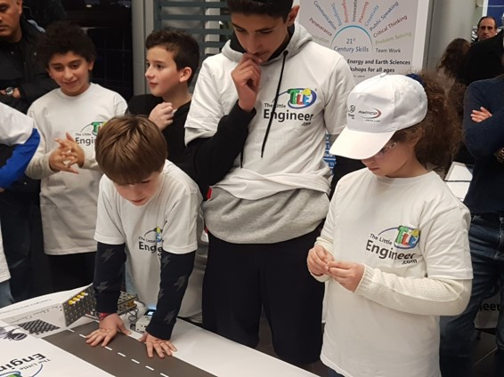
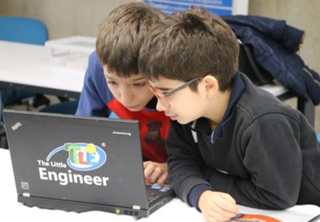
Hi-Tech Camps for Chaps
By The Little engineer ®
In Dubai- Al Barsha Heights
Al Ameri Tower – Office 504
March 28 to April 15
Three weeks of amazing STEAME Workshops
To prepare young minds and youth for the 4th industrial revolution

Slide 5
Camp Structure
Hi Tech Camps
For Champs
BY TLE®
8 students/shift
2 Instructors
2 Instructors
12 students
Age 10-12
From 9- 1PM
Age 6-9
From 9 to 1 PM

Slide 6
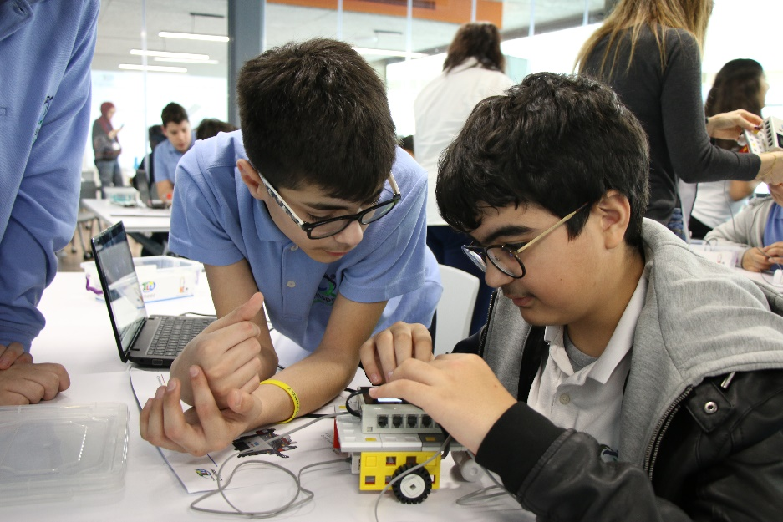
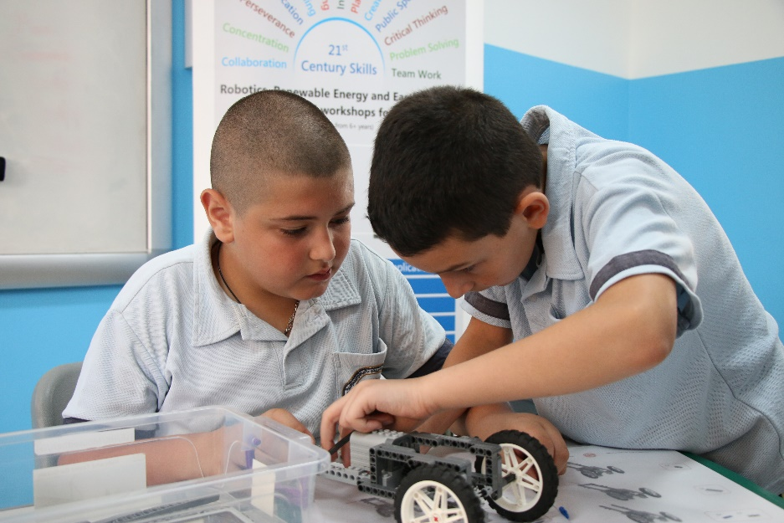
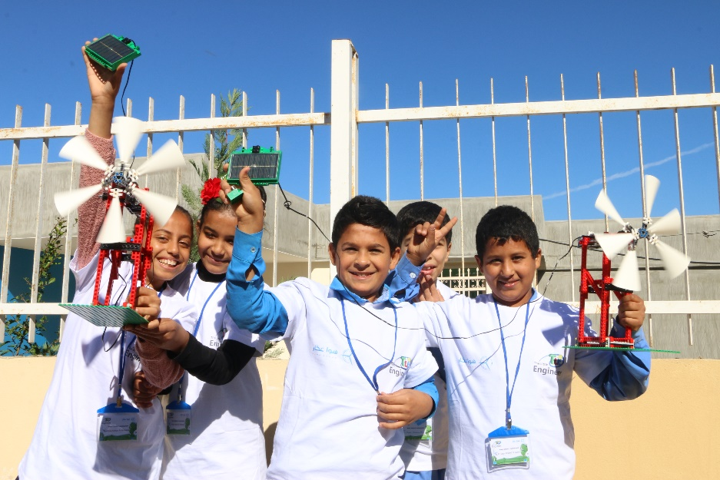
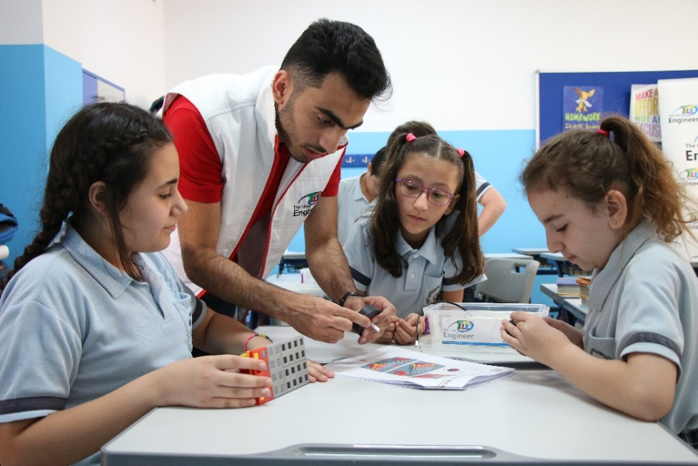
Suggested Activities and Schedule for Age 6 -9

Slide 7
Age 6-9 topics
Robotics
3D MODELING
Technology
Creativity
Renewable Energy

Slide 8
Age 6 - 9 Schedule

Slide 9
Age 6 - 9 Schedule

Slide 10
Age 6 - 9 Schedule

Slide 11
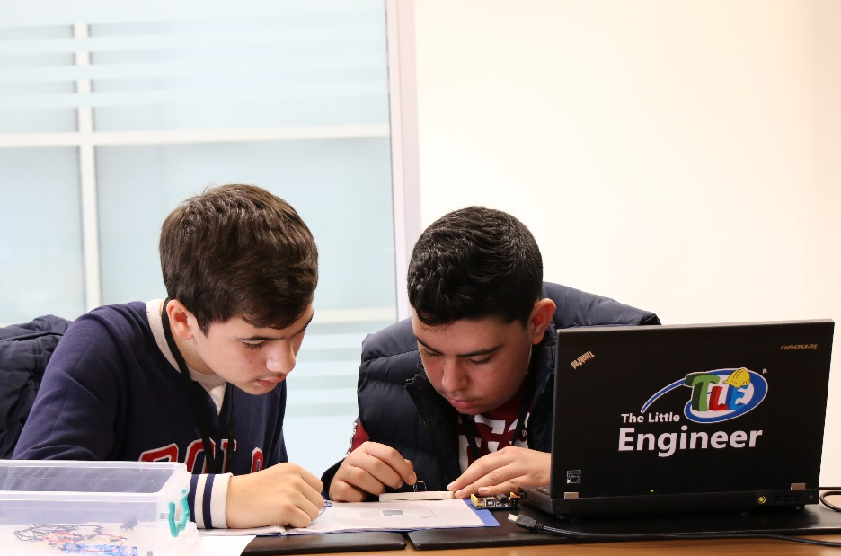
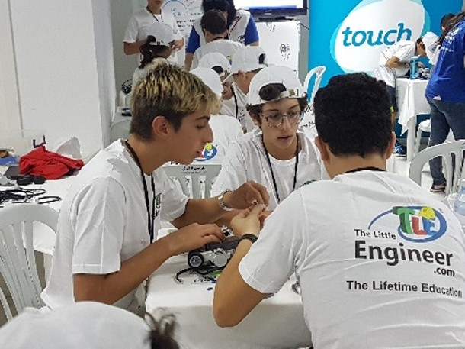
Suggested Activities and Schedule for Age 10-12

Slide 12
Age 10-12
Robotics
3D MODELING
Machine Learning
WEB Design
Renewable Energy
Financial Literacy
Game Design
Entrepreneurship

Slide 13
Age 12-16 Schedule

Slide 14
Age 10 -12 Schedule

Slide 15
Age 10-12 Schedule

Slide 16
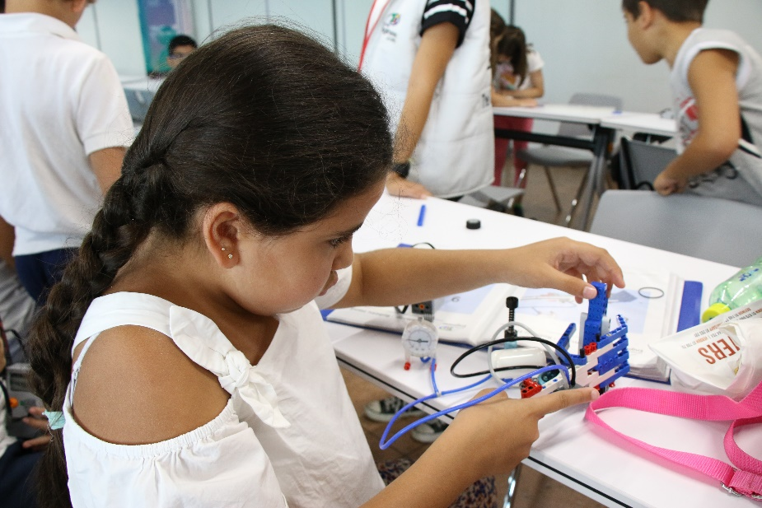
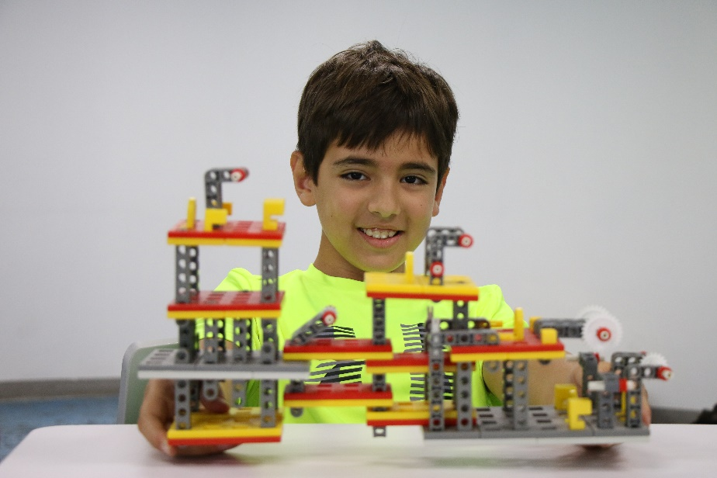
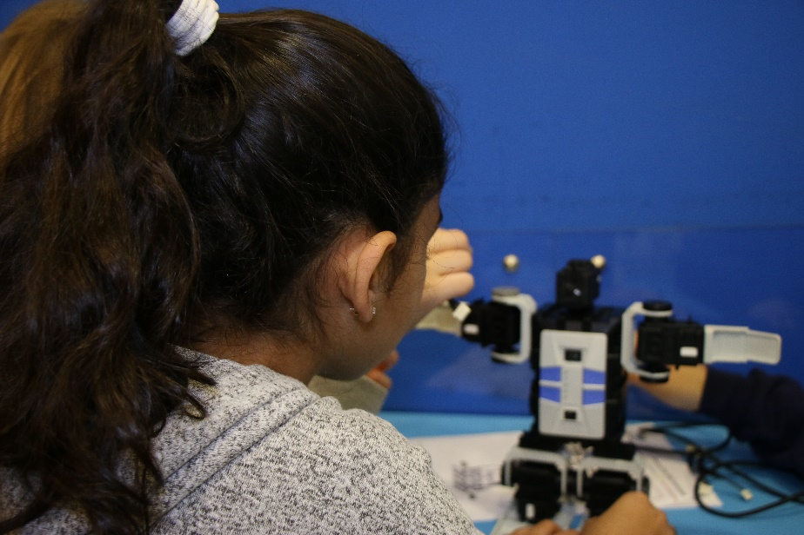
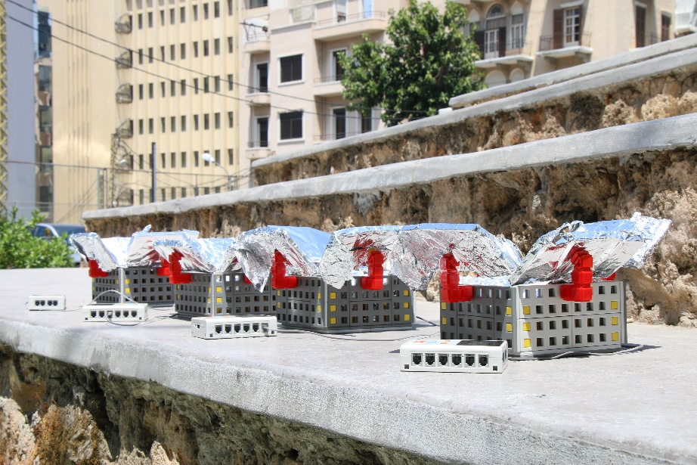
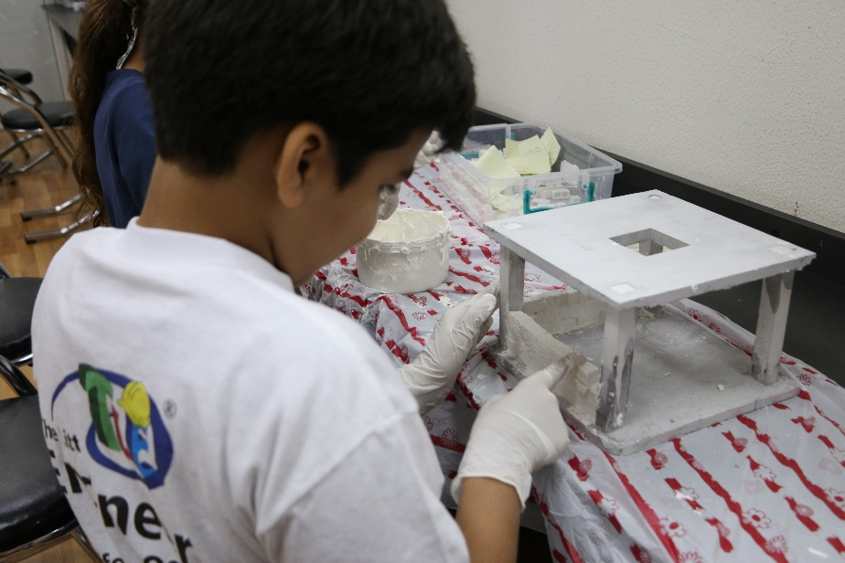
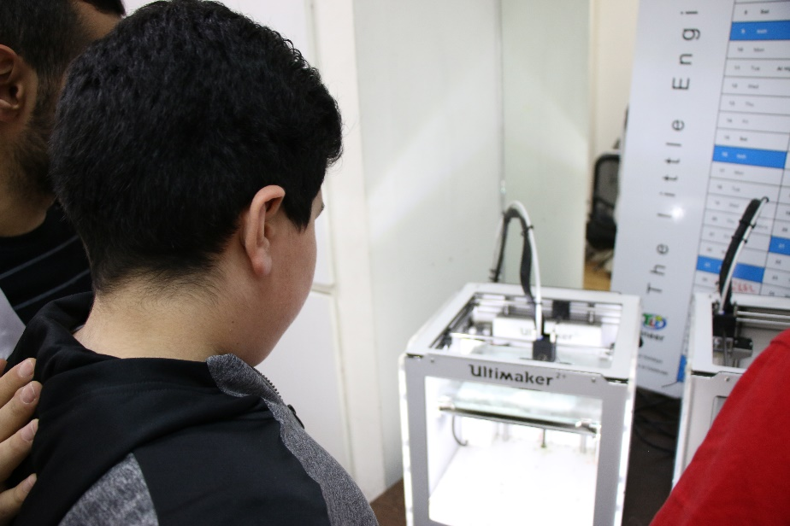

Slide 17
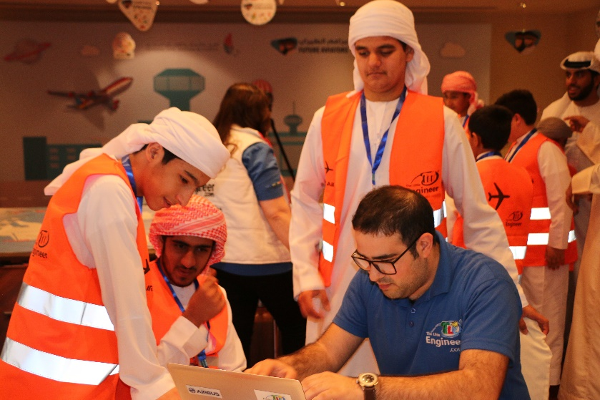
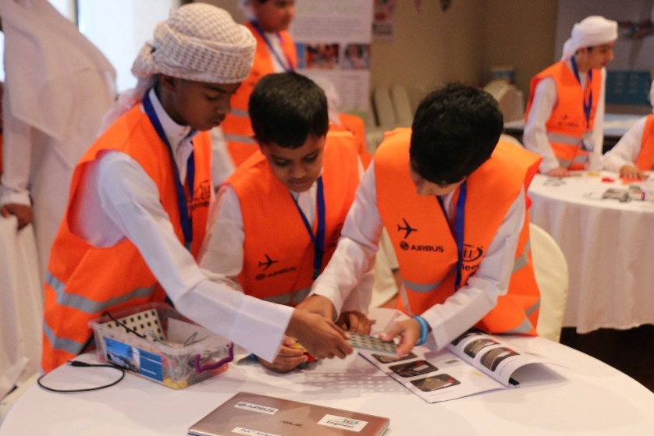
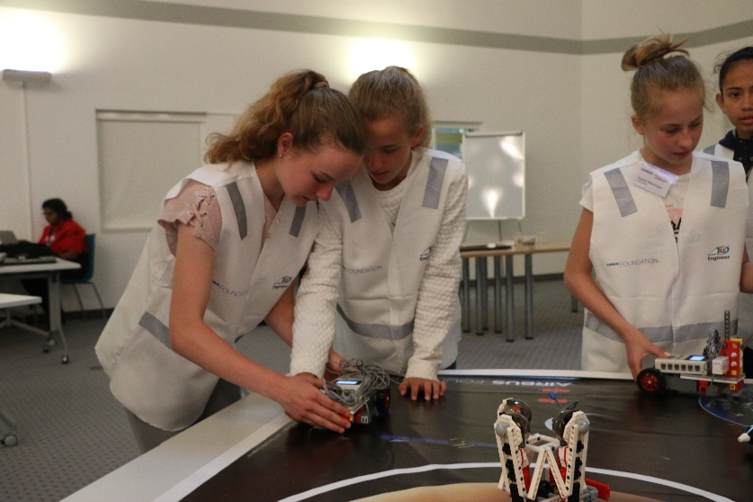
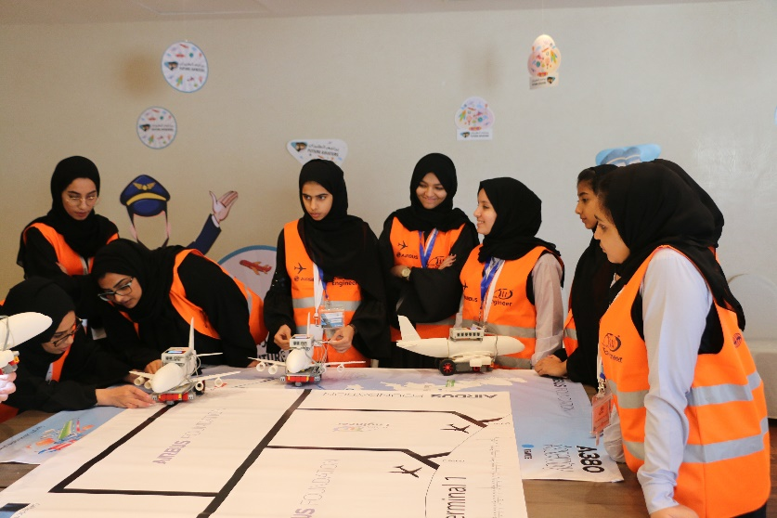
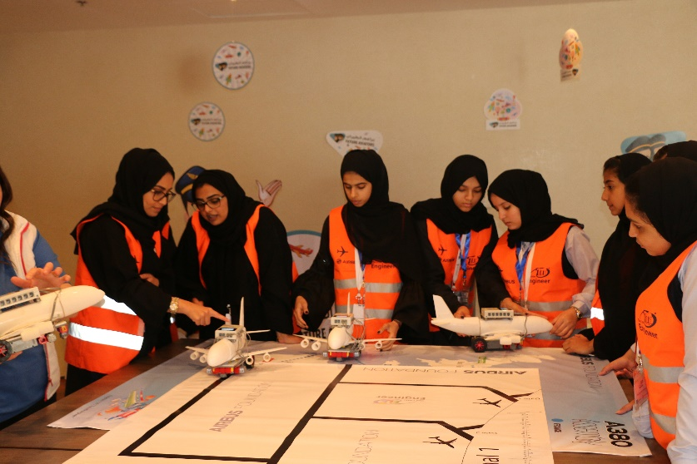


Slide 18
Camp Fees
4 days | From Monday till Thursday
from 9 Am till 1 Pm
800 AED
Visit our website to book a seat Here

Slide 19
Some Videos from our camps
TLE x Sabic Camp 2015 : https://www.youtube.com/watch?v=Zh00yLJWJDM
TLE Green Energy Activities: https://www.youtube.com/watch?v=4mRmTGwpNaA
TLE Summer Camp 2019: https://www.youtube.com/watch?v=YR0iamxqalI
TLE Winter Camp 2019 : https://www.youtube.com/watch?v=F1GZinJn25k
TLE Camp in UAE : https://youtu.be/g3T09I6KuxQ

Slide 20





call
Call : 00971504648005
We are a voice of change

